Slide 1

Building Modern Mobile Apps - Wrap-up
Kevin Ford
Mobile Practice Lead
Magenic
Brent Edwards
Principal Lead Consultant
Magenic
Level: Intermediate

Slide 2
Kevin Ford
KevinF@magenic.com
@Bowman74
http://windingroadway.blogspot.com
https://github.com/Bowman74
BrentE@magenic.com
@brentledwards
http://www.brentedwards.net
https://github.com/brentedwards
Brent Edwards

Slide 3

Things to Think About
Project or Product?
KPIs and Understanding Success
Mobile Platforms
Mobile Development Platforms
Lifecycle Tools
Deployment Options

Slide 4
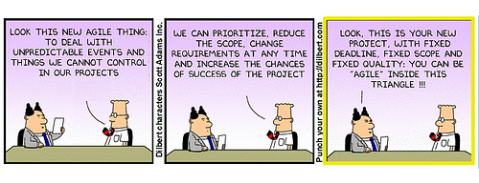
The Dilemma
“Product” Thinking
“Project” Thinking

Slide 5
Why Product Approach is Uniquely Important for Mobile
Competitive bar—and users’ expectations—frequently reset and always higher
Constant introduction of new technology increases technical and strategic risks
May take ~4 major releases (especially for consumer products) to understand user behavior, gather data, realize value
Complex technical capabilities and ecosystem make designing and maintaining the right experience a continuing journey
Focus on and funding for mobile increasingly driven by CMOs—more likely to think strategically and in terms of product

Slide 6




Let’s Compare (1 of 3)
Mobile Project (“IT Mindset”)
Mobile Product Mindset
Serve needs of the customer within business constraints
Purpose
Serve needs of “the business”
Passion
Resources are transient mercenaries
Focused resources are missionaries
Gather from stakeholders; focus on documentation
Discover through user interaction; focus on flexibility and communication
Requirements
Funding and
Measurement
Projects (output), managed by IT delivery timeline and budget
Business results (outcome managed by KPIs aligned to business objectives
Notes:
credits to Marty Cagan and Moonshot Horizon
http://svpg.com/product-vs-it-mindset
https://www.moonshothorizon.com/2015/07/02/how-to-launch-impactful-digital-products/

Slide 7




Let’s Compare (2 of 3)
Mobile Project (“IT Mindset”)
Mobile Product Mindset
Process
Skews toward Waterfall
Requires Agile
Style
Optimized for individuals, handoffs
Focused on team collaboration
Organization
IT manages, reports to CIO
CIO and CMO/LOB share leadership of single cross-functional team
Accountability
IT and “the business” at odds; likely to accrue technical debt without repercussion
Product team blends tech/business; approach de-incentivizes shortcuts

Slide 8




Let’s Compare (3 of 3)
Mobile Project (“IT Mindset”)
Mobile Product Mindset
Technology feared; source of risk, uncertainty and doubt
Technology valued as business enabler, co-innovators
Leadership
Tools
Word docs, emails, change requests
Collaboration tools, prototypes, backlogs, ongoing prioritization
Output
Focused on documentation, volume of features(more is better)
Focused on simulating & identifying valuable experiences (learning better)
Frequent, small iterative/incremental releases (test and learn; manage risk)
Implementation
Big Bang, feature-heavy releases

Slide 9
Approach Criteria
Might be a Project if…
Might be a Product if…
Corporate-supplied and managed device
No vision for future functionality
Not customer-facing*
Not strategic for the business
Success will be measured in terms of timelines, scope and budget
Will be owned by IT
Static user environment
BYOD or customer-facing
Strategic (e.g., competitive differentiator)
Aligned with key business objectives
Product owner and roadmap focused on customers’ needs
Investment will be measured; KPIs
Dynamic environment
Back office/third party integration

Slide 10
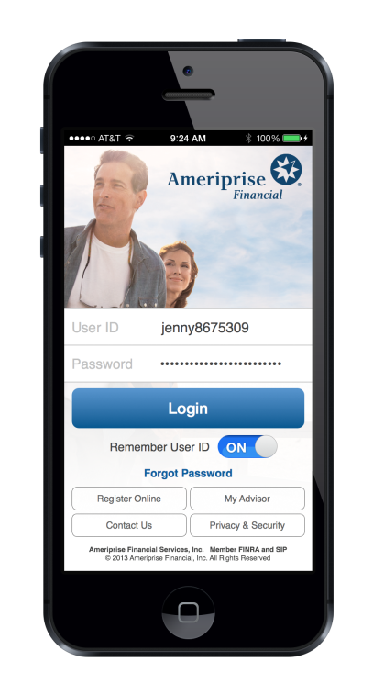
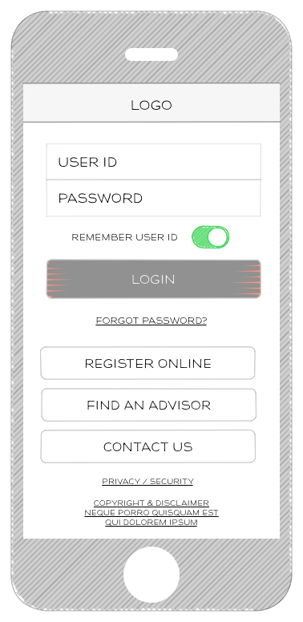

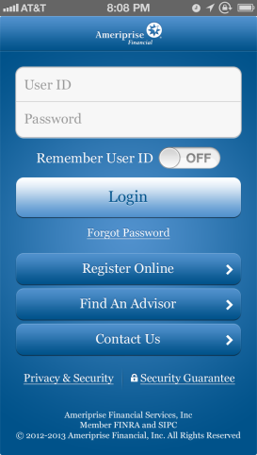

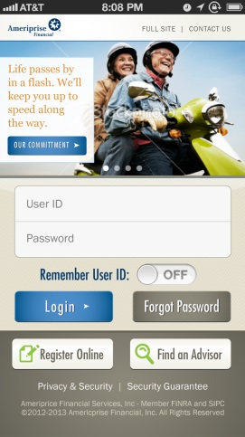


Needs of the Customer
Previous Release
Wireframe
Initial Redesign
Design & Branding Exploration
Final Redesign

Slide 11
Importance of KPIs
What is important?
Story Prioritization
MVP Understanding
How the app needs to change - learning
What information will tell you if KPIs are met?
How do I gather that information?

Slide 12
Tracking KPIs
What to Track
Crash Reporting
Who is using the app
How the app is being used
Privacy / security / legal concerns
App store ratings
Notes:
How does each one of these fit into development technology?
HockeyApp
Crashlytics
Crittercism (Apteligent)
Flurry
Raygun

Slide 13
Mobile Platform Choices

Slide 14
Mobile Platform Choices
Needs of today’s apps and tomorrows
Do you know your user’s platforms?
Are there dominant platforms
Can you control it?
Does the use case require a specific form factor?
How do they connect? Cell, Wifi, etc?

Slide 15


Choosing a Mobile Development Platform
No “Correct” Choice for all situations
Responsive Web
Hybrid
No, your other right!
Near Native X-Platform (Xamarin, Native Script, React Native)
Native (XCode, Android Studio, UWP)
X-Platform App Builders (SFDC, Kony, IBM) and mBaaS (Kidozen, Kinvey)

Slide 16
STANCE
Speed / performance
Time to complete / cost
Always working with newest standards / APIs
Native User Experience
Complex hardware / API intereactions
Enterprise services / tools

Slide 17
Development Technologies

Slide 18
Development Technologies

Slide 19
CPU Intensive Tasks - iOS

Slide 20
CPU Intensive Tasks - Android

Slide 21
Lifecycle Tools
Project Management
Source Control
Unit Tests
CI / Automated Tests / Device Stable
Deployment to QA / UAT

Slide 22
Deploying to QA / UAT
iOS needs special provisioning
Individual developer account / Ad Hoc
Corporate Provisioning Profile
Usually Special Tooling is desired
Side Loading is possible
Potentially download from URL
Notes:
HockeyApp
TestFlight
TestFairy

Slide 23
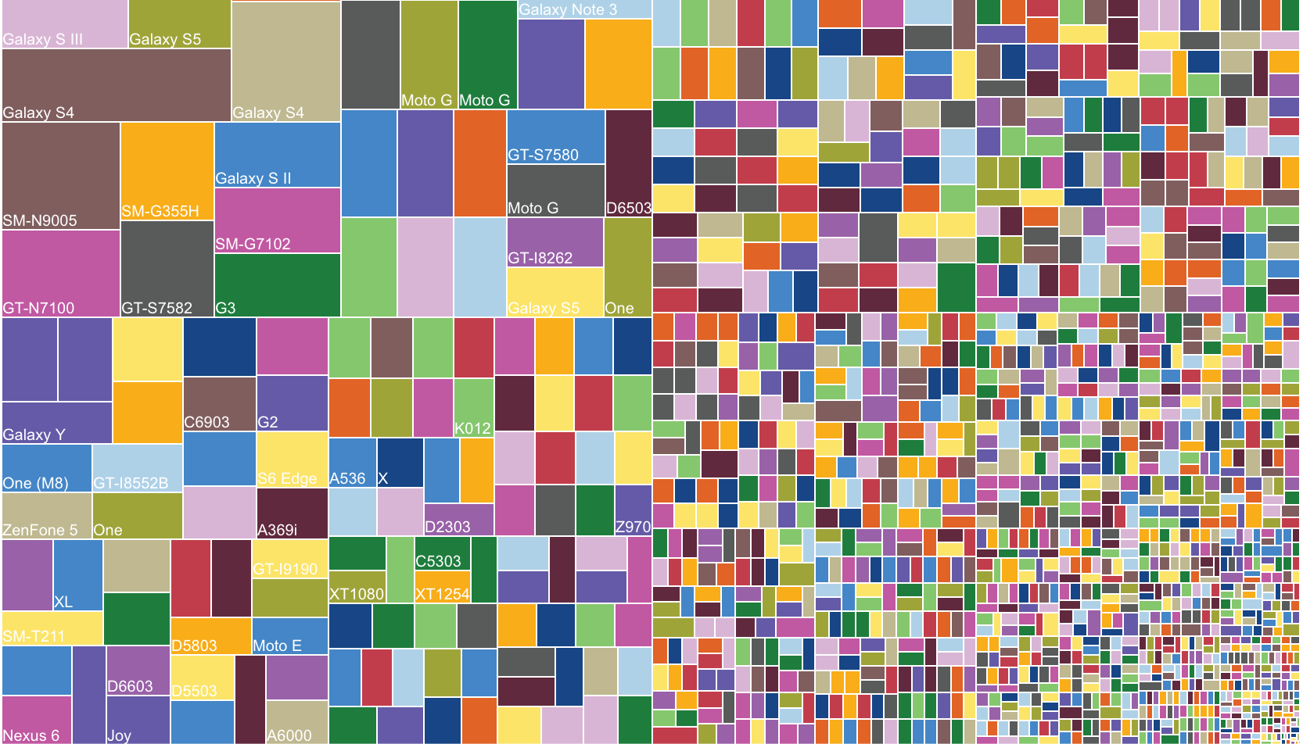
CI and Automation
iOS needs special handling
Obj-C / Swift Builds need Macs
Any build that will be deployed to a device: needs a Mac
Potential for MacInCloud.com
Each Platform has Different Unit Test Solutions
Think about Test automation, particularly coded UI tests

Slide 24
Deployment Options
App Stores
Lag on deployment
Someone else will decide if your app is ready
Restrictions on what app can do
MDM / MAM / Corporate App Stores
Web / Side Loading
Notes:
Mobile Device Management
Mobile Application Management
Web – side loading may require certificates to be installed

Slide 25
Summing It Up
No Silver Bullet
Understand the business objectives first
Today’s objective’s
Tomorrow’s too
Think all aspects of development process

Slide 26
Questions

